Slide 1
Scope of today’s work
Recap: Cruising (constructing) S(T,P) by integrating its slopes
Today:
Existence check (CGI): testing whether a quantity really is a state function
Using the cross-integration method
Using the cross-derivative method
An introduction to Maxwell’s equations and the box
A new thermodynamic identity: Euler’s Chain Rule
Two mysteries of thermodynamics revealed

Slide 2
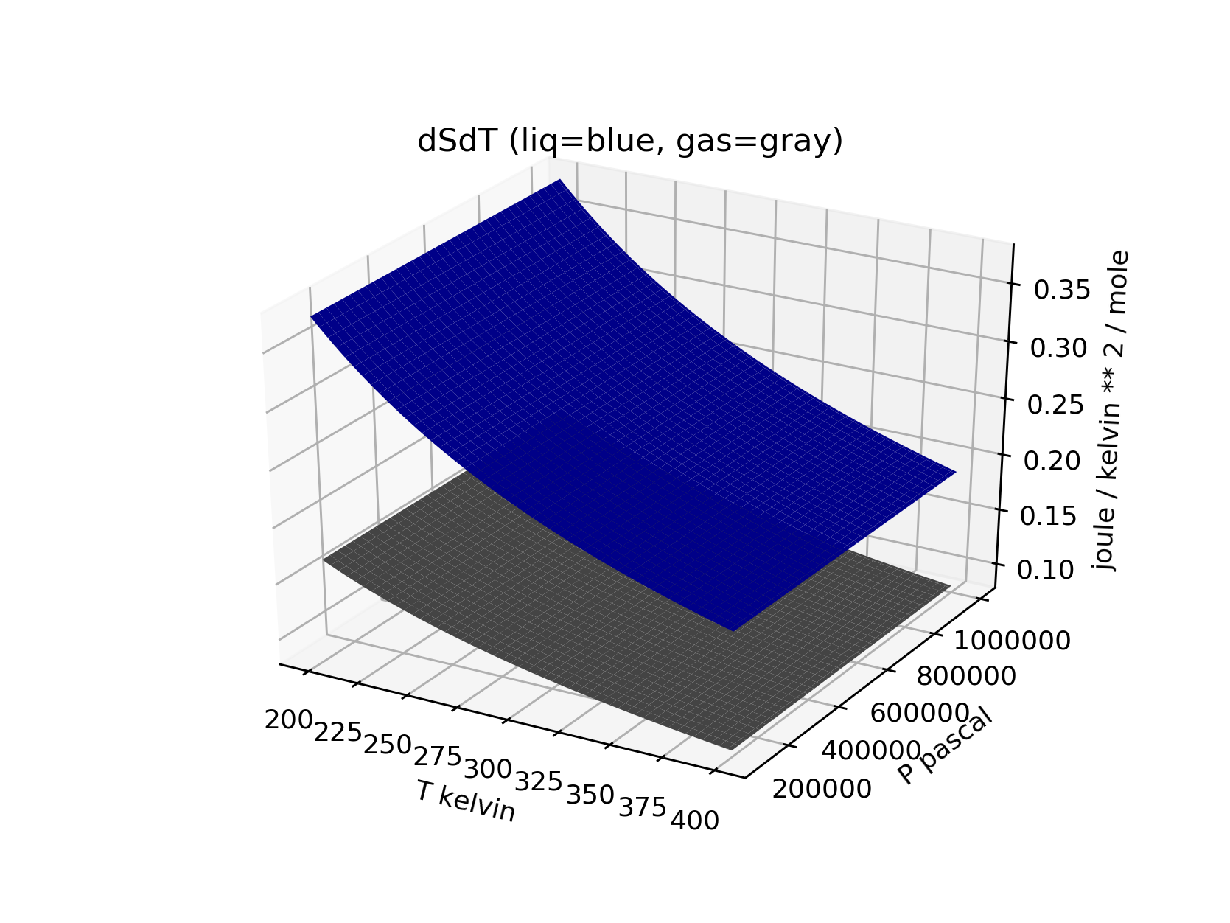
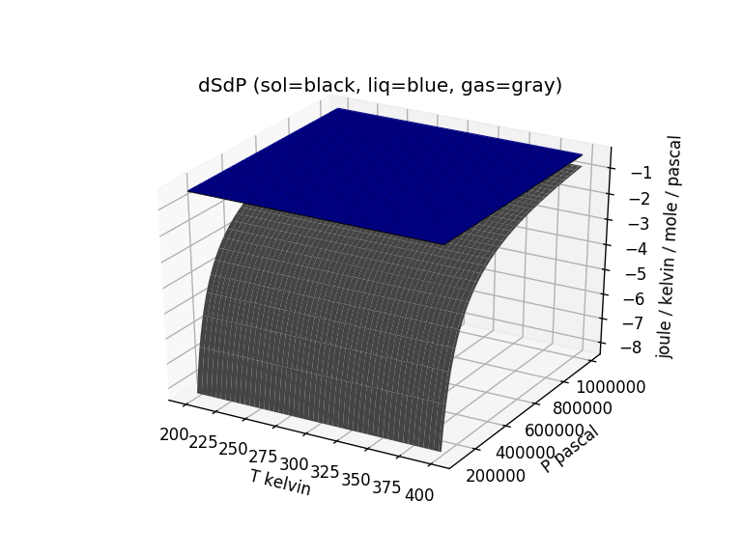
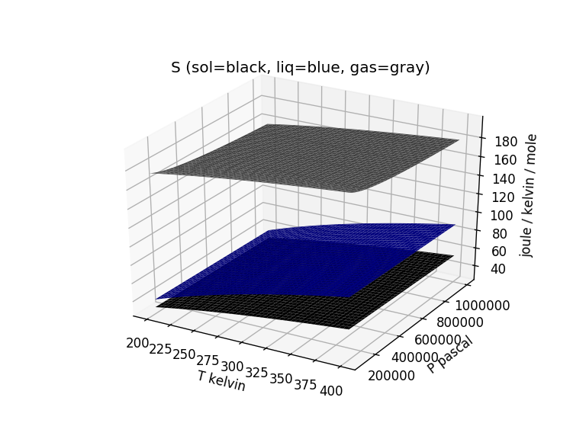

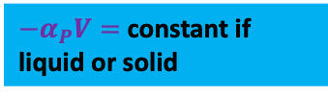
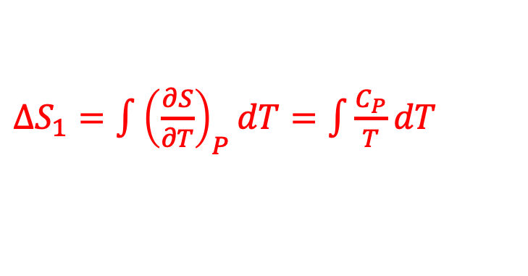




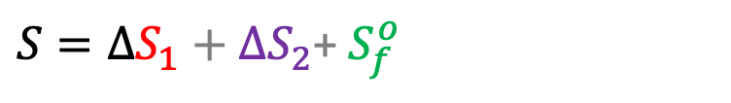

Recap: Cruising (constructing) S(T,P) by integrating over temperature and pressure
${−α}_{P}V=$constant if liquid or solid
$\frac{C_{P}}{T}$
${−α}_{P}V= −\frac{R}{P}$ if a gas
$${−α}_{P}V$$
$∆S_{1}=\int{{\left(\frac{∂S}{∂T}\right)}_{P}dT}=\int{\frac{C_{P}}{T}dT}$
$∆S_{2}=\int{{\left(\frac{∂S}{∂P}\right)}_{T}dP}=−\int{α_{P}VdP}$
$${\left(\frac{∂S}{∂P}\right)}_{T}$$
$${\left(\frac{∂S}{∂T}\right)}_{P}$$
$S=∆S_{1}+∆S_{2}$+ $S_{f}^{o}$

Slide 3
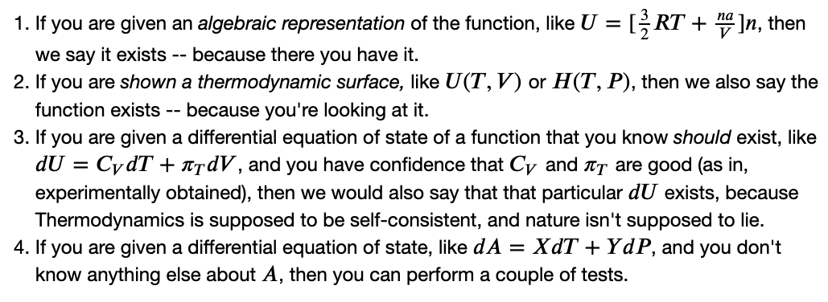
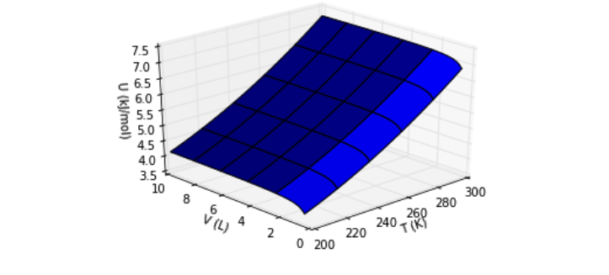
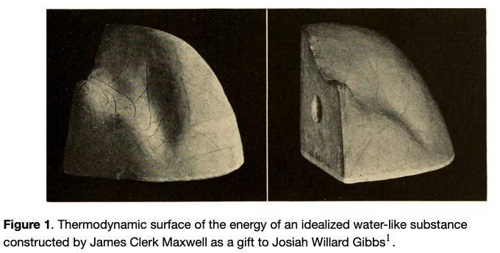
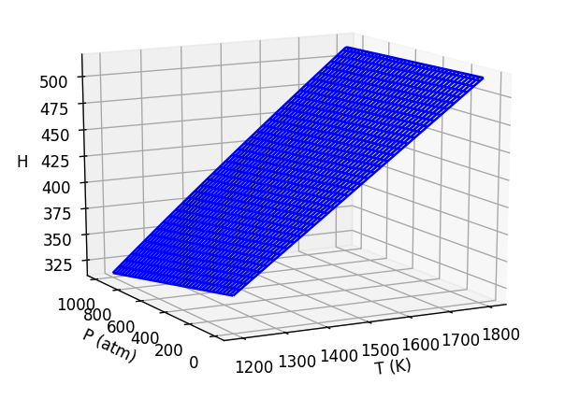



I. Existence check: How to tell whether a state function actually exists
$$U(T,V)$$
$$S(T,P)$$
$$H(T,P)$$

Slide 4
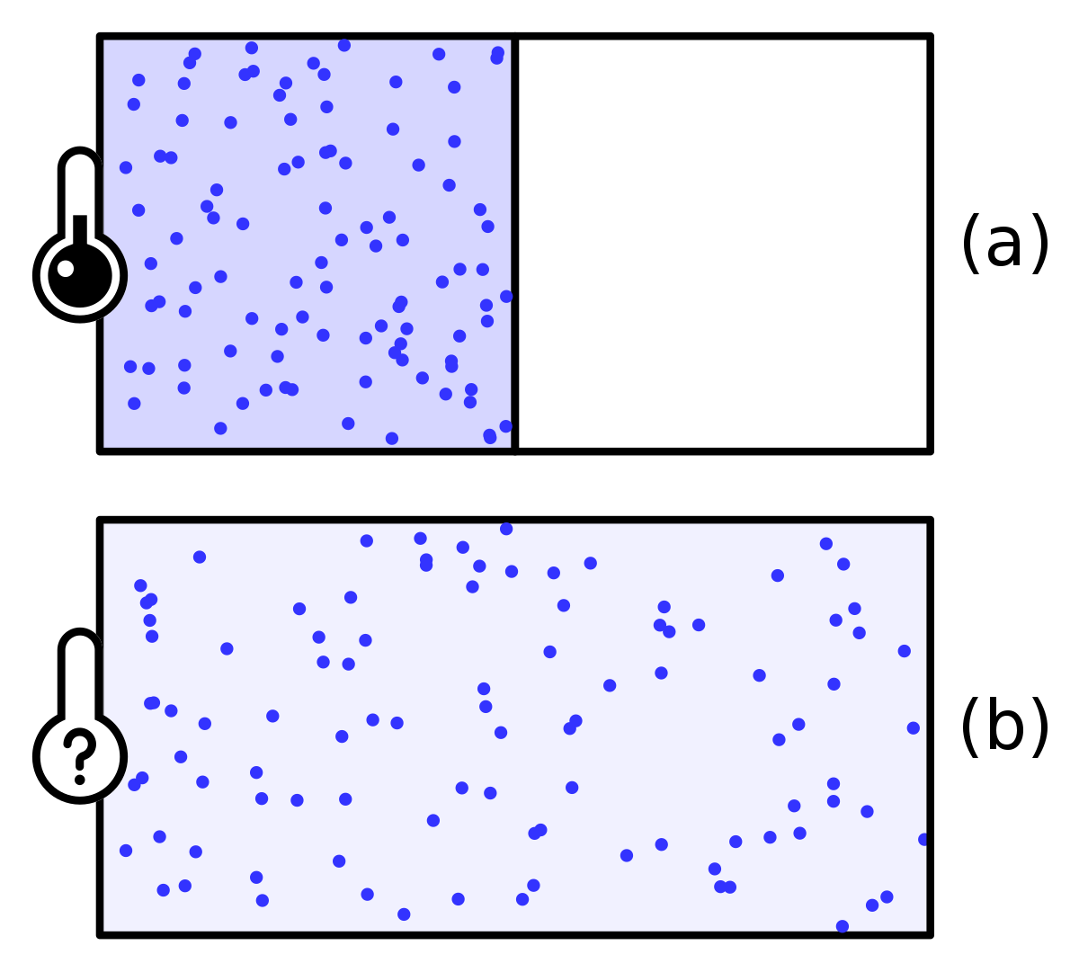



I. Existence check: How to tell whether a state function actually exists
Measuring $C_{P}$ with a differential scanning calorimeter
Measuring $π_{T}$

Slide 5
I. Existence check: How to tell whether a state function actually exists
Cross-integration test
Cross-derivative test

Slide 6
I. Existence check: How to tell whether a state function actually exists
Cross-integration test
Cross-derivative test

Slide 7
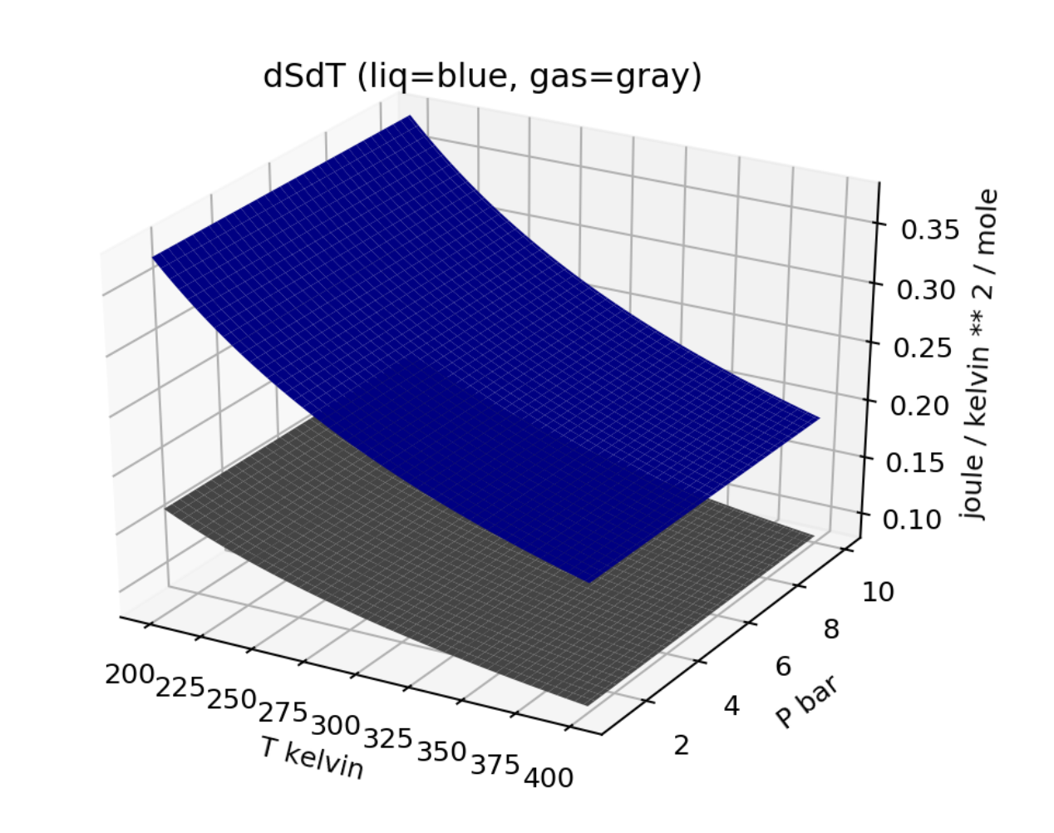
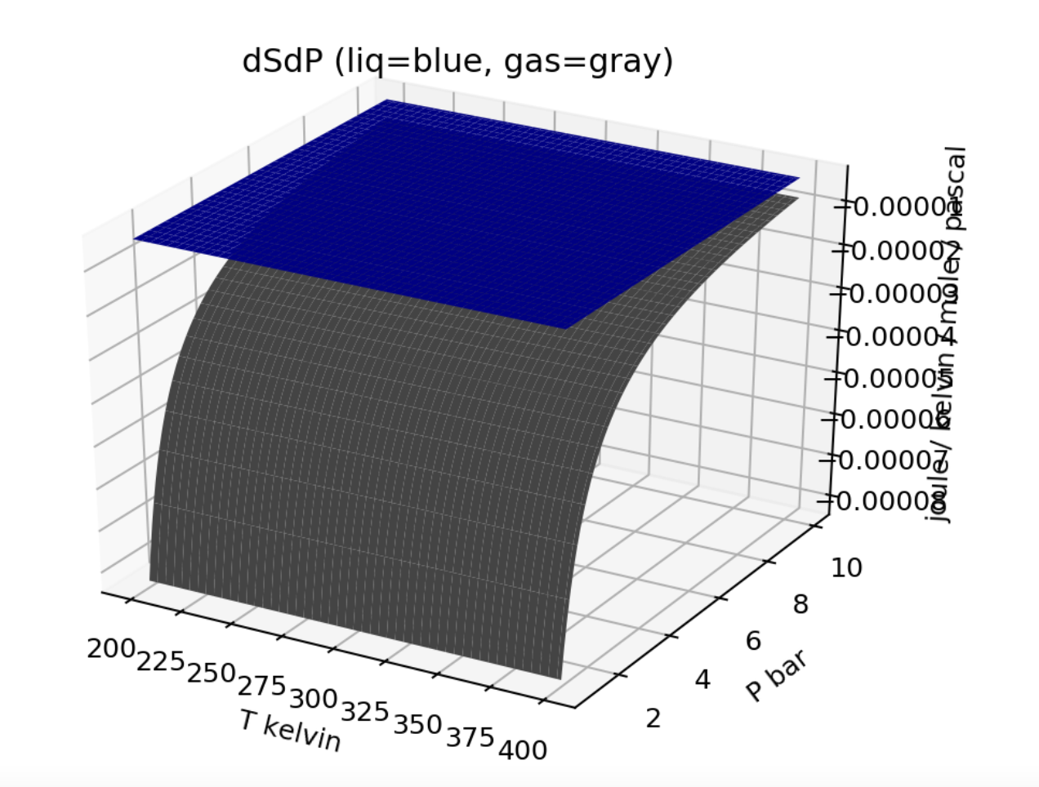

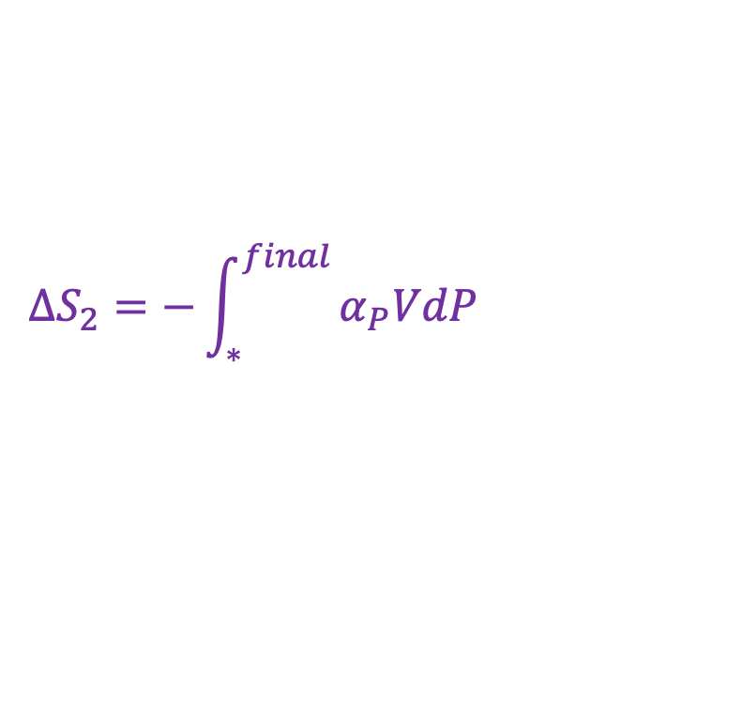
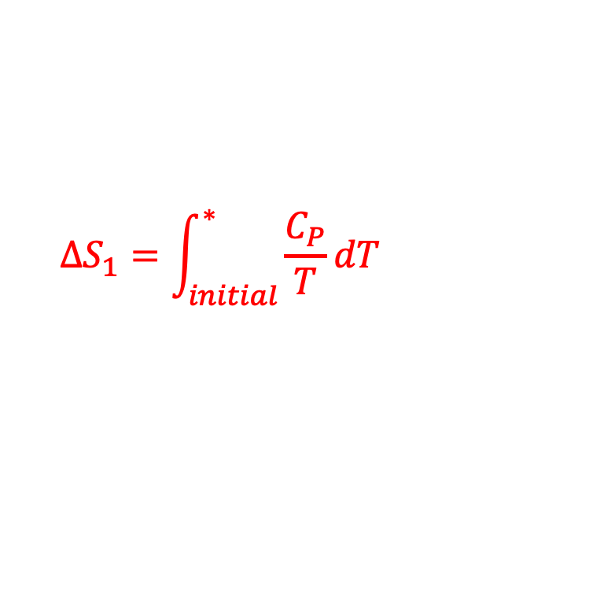
Cross-integration
*
*
$$∆S_{1}=\int_{initial}^{∗ }{\frac{C_{P}}{T}dT}$$
$$∆S_{2}=−\int_{∗}^{final }{α_{P}VdP}$$
$$∆S=$$
$$∆S_{1}+∆S_{2}$$
Integrate over temperature first, then pressure

Slide 8

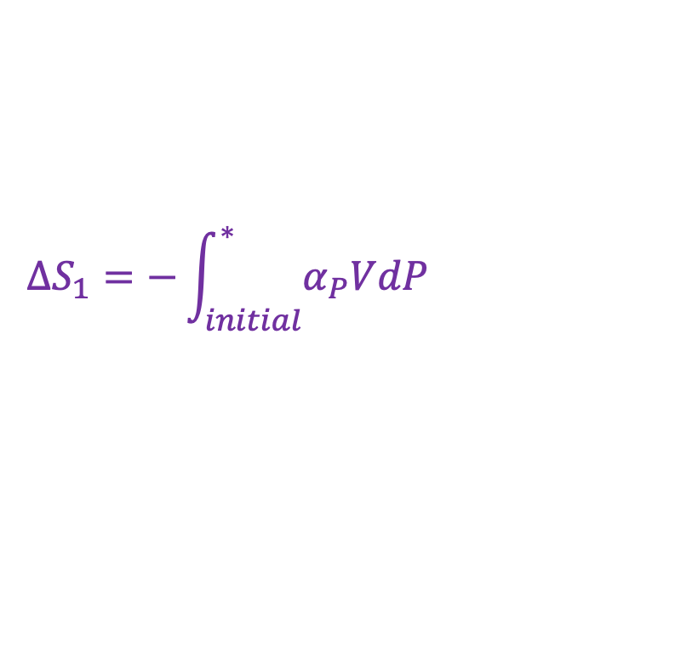
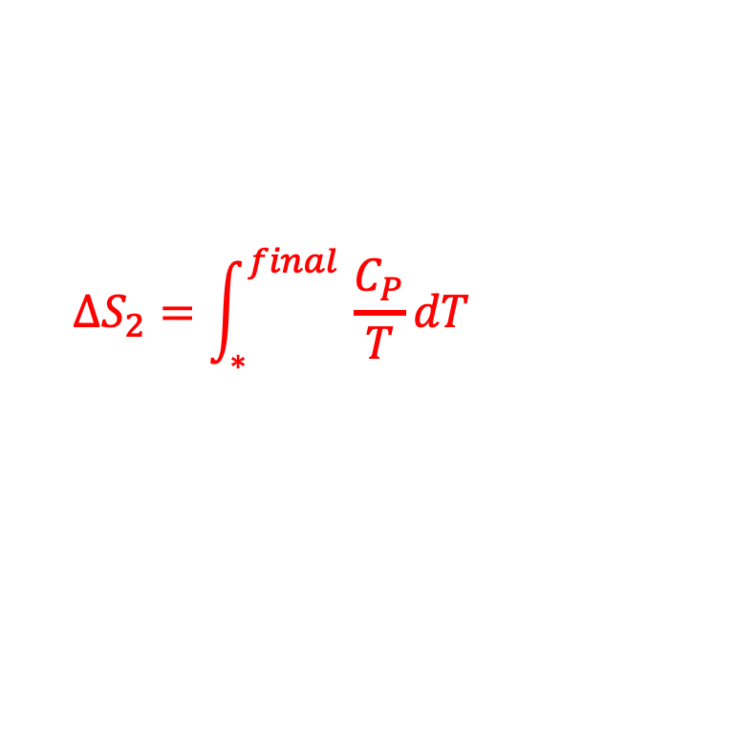
Cross-integration
$$∆S_{1}=−\int_{initial}^{∗ }{α_{P}VdP}$$
$$∆S_{2}=\int_{∗}^{final }{\frac{C_{P}}{T}dT}$$
$$∆S=$$
$$∆S_{1}+∆S_{2}$$
Integrate over pressure first, then temperature

Slide 9

Cross-integration
$$∆S=$$
$$∆S_{1}+∆S_{2}$$
We should get the same S(T,P) regardless of the order

Slide 10
I. Existence check: How to tell whether a state function actually exists
Cross-integration test
Cross-derivative test

Slide 11
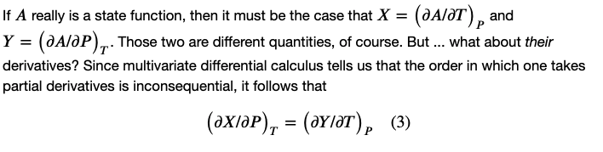

Cross-derivative
Cross-integration test
Cross-derivative test

Slide 12
I. Existence check: How to tell whether a state function actually exists
Your tasks:
Do the cross-integration test in Python*
Do the cross-derivative test on the blackboard
*

Slide 13
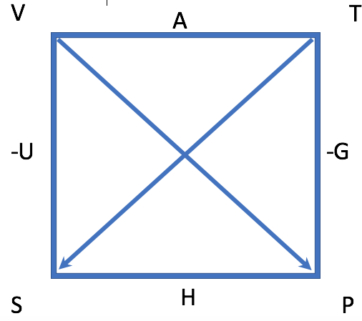
II. Maxwell’s equations and the box
The box

Slide 14
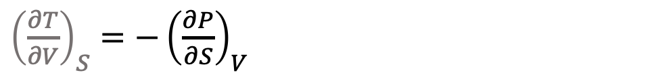
II. Maxwell’s equations and the box
Your task:
Work out all four Maxwell relations
${\left(\frac{∂T}{∂V}\right)}_{S}=−{\left(\frac{∂P}{∂S}\right)}_{V}$

Slide 15
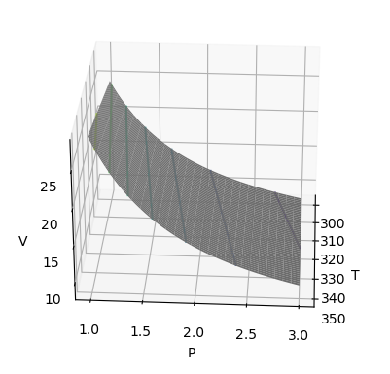

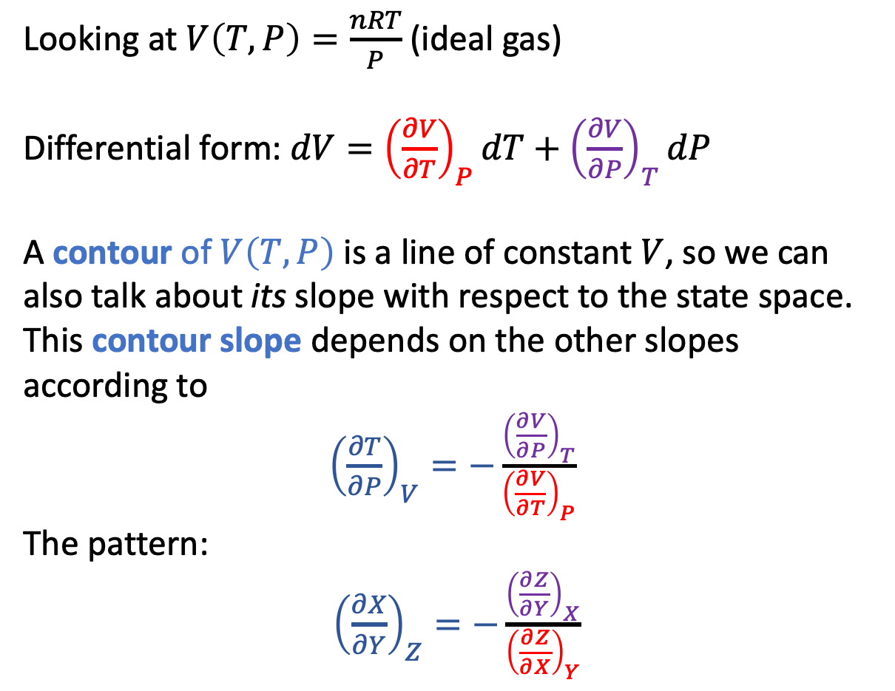



III. Euler’s Chain Relation (AKA the contour slope rule)
Looking at $V\left(T,P\right)=\frac{nRT}{P}$ (ideal gas)
Differential form: $dV={\left(\frac{∂V}{∂T}\right)}_{P}dT+{\left(\frac{∂V}{∂P}\right)}_{T}dP$
A contour of $V\left(T,P\right)$ is a line of constant $V$, so we can also talk about its slope with respect to the state space. This contour slope depends on the other slopes according to
${\left(\frac{∂T}{∂P}\right)}_{V}=−\frac{{\left(\frac{∂V}{∂P}\right)}_{T}}{{\left(\frac{∂V}{∂T}\right)}_{P}}$
The pattern:
${\left(\frac{∂X}{∂Y}\right)}_{Z}=−\frac{{\left(\frac{∂Z}{∂Y}\right)}_{X}}{{\left(\frac{∂Z}{∂X}\right)}_{Y}}$
$${\left(\frac{∂V}{∂T}\right)}_{P}$$
$${\left(\frac{∂V}{∂P}\right)}_{T}$$
$${\left(\frac{∂T}{∂P}\right)}_{V}$$
Your task:
Work out ${\left(\frac{∂P}{∂T}\right)}_{V}$

Slide 16
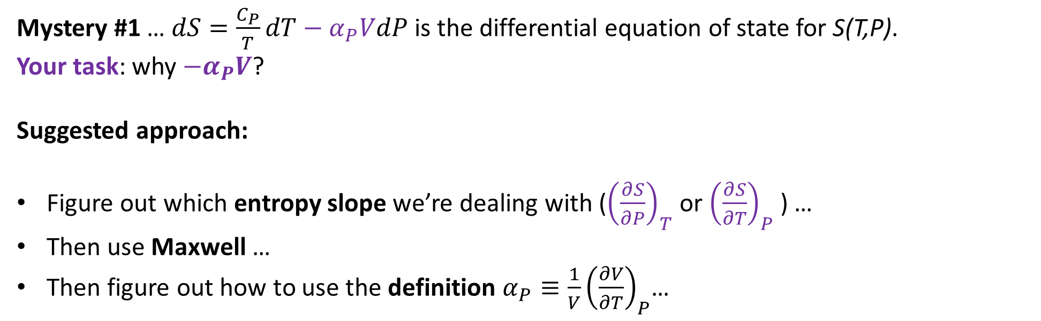
IV. Mysteries revealed
Mystery #1 … $dS=\frac{C_{P}}{T}dT−α_{P}VdP$ is the differential equation of state for S(T,P).
Your task: why $−α_{P}V$?
Suggested approach:
Figure out which entropy slope we’re dealing with (${\left(\frac{∂S}{∂P}\right)}_{T}$ or ${\left(\frac{∂S}{∂T}\right)}_{P}$ ) …
Then use Maxwell …
Then figure out how to use the definition $α_{P}≡\frac{1}{V}{\left(\frac{∂V}{∂T}\right)}_{P}$…

Slide 17
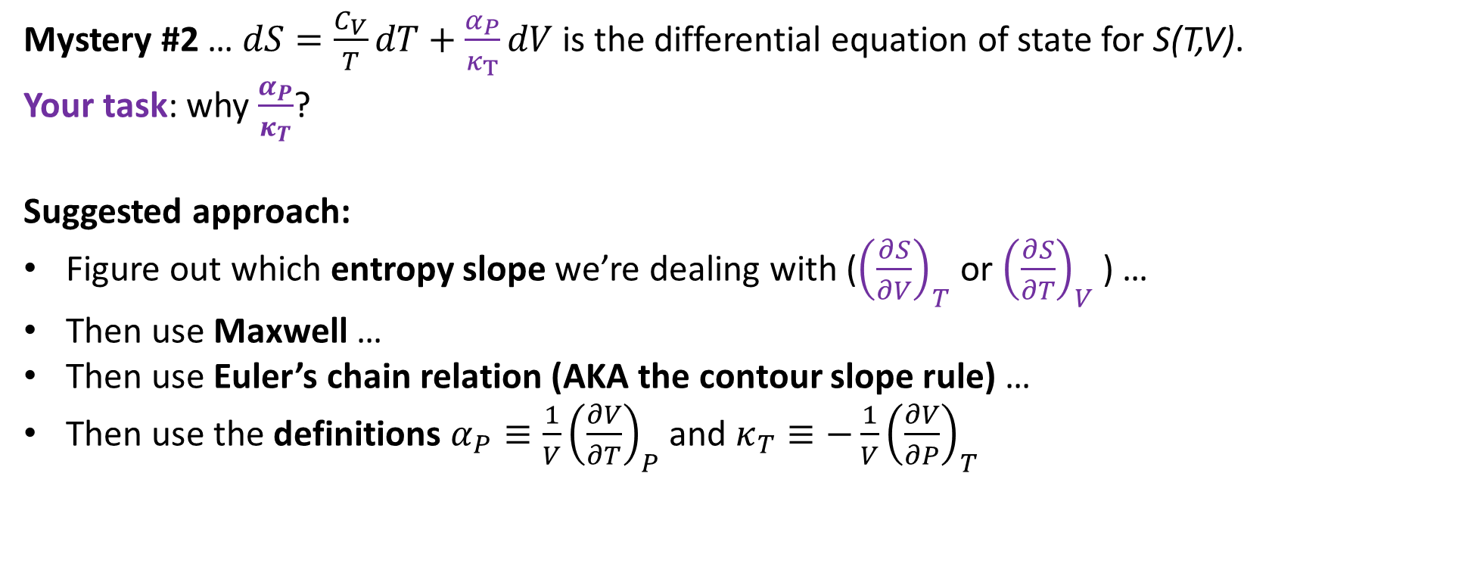
IV. Mysteries revealed
Mystery #2 … $dS=\frac{C_{V}}{T}dT+\frac{α_{P}}{κ_{T}}dV$ is the differential equation of state for S(T,V).
Your task: why $\frac{α_{P}}{κ_{T}}$?
Suggested approach:
Figure out which entropy slope we’re dealing with (${\left(\frac{∂S}{∂V}\right)}_{T}$ or ${\left(\frac{∂S}{∂T}\right)}_{V}$ ) …
Then use Maxwell …
Then use Euler’s chain relation (AKA the contour slope rule) …
Then use the definitions $α_{P}≡\frac{1}{V}{\left(\frac{∂V}{∂T}\right)}_{P}$ and $κ_{T}≡−\frac{1}{V}{\left(\frac{∂V}{∂P}\right)}_{T}$

